Slide 1



Blktrace
오기환
wurikiji@skku.edu
Notes:
Thank you for introduction. (사회자 진행후)
My name is Gihwan Oh.
Today,/ I will present our recent work/ on SQLite Optimization with Phase Change Memory for Mobile Applications.
As far as we know,/ this is the first work/ in database community/ using real PCM Chips.
This is a joint work with my advisor/ Sang-Won Lee at S K K U,(천천히) Sangchul Kim/ and Bongki Moon at Se Na Un.
====
====== dGood afternoon everyone
We designed and Implemented a new physiological Logging system for SQLite with a Real PCM
We call this new approach Per-page-logging with PCM, and in short PPL.

Slide 2
Block I/O tracing
blktrace
blktrace is a block layer IO tracing mechanism which provides detailed information about request queue operations.
Package Components
blktrace
blktrace is utility for tracing. Trace results are saved to binary file.
blkparse
blkparse is utility for parsing trace result. It reads trace results from binary file and parses.

Slide 3
Structure
Application
User
System Call Interface
Virtual File System
XFS
EXT4
F2FS
Buffer Cache
Request Queue
Kernel
Device Driver
Hardware

Slide 4
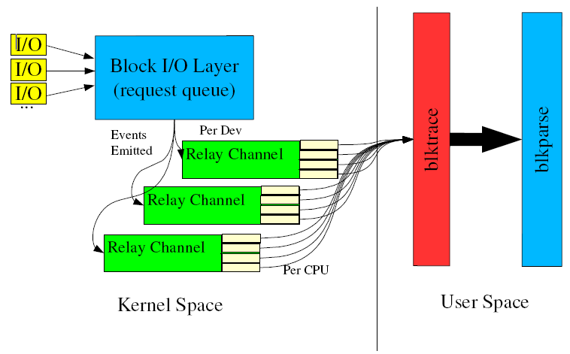
Structure

Slide 5
How to install
Run ‘sudo apt-get update’
Run ‘sudo apt-get install blktrace’

Slide 6
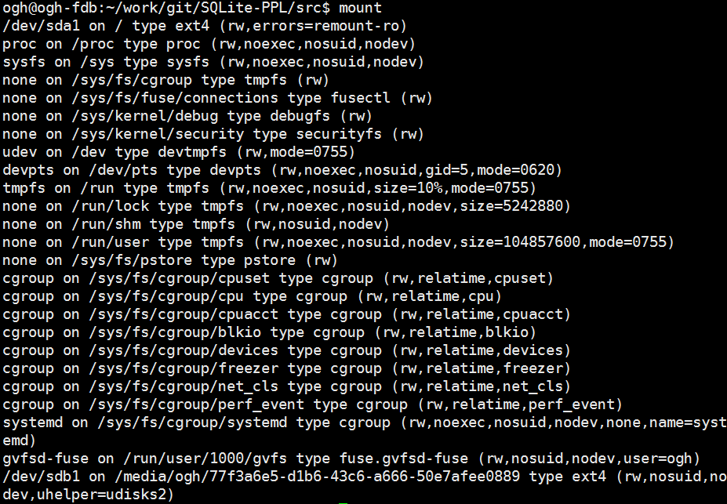
Usage
Find your device

Slide 7
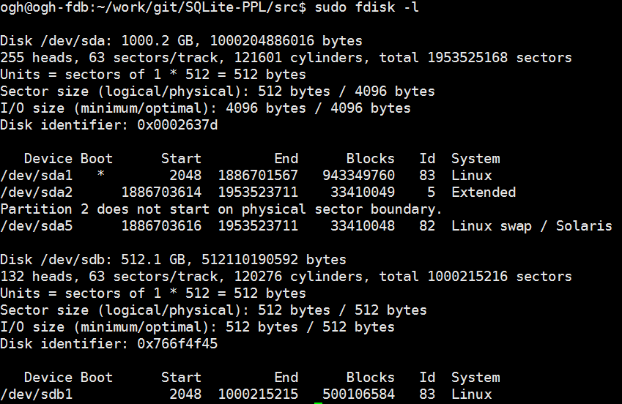
Usage
Find your device path
‘sudo fdisk –l’

Slide 8
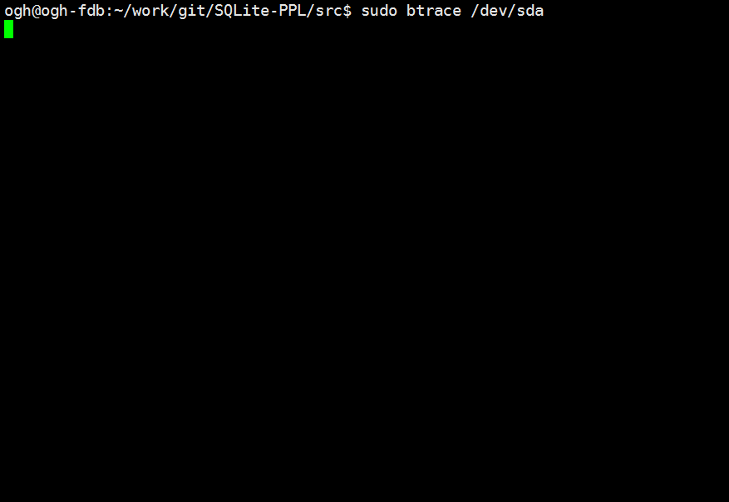
Usage
Run blktrace before testing
‘sudo btrace /dev/sda’ or
‘sudo btrace /dev/sda > output’ for redirection

Slide 9
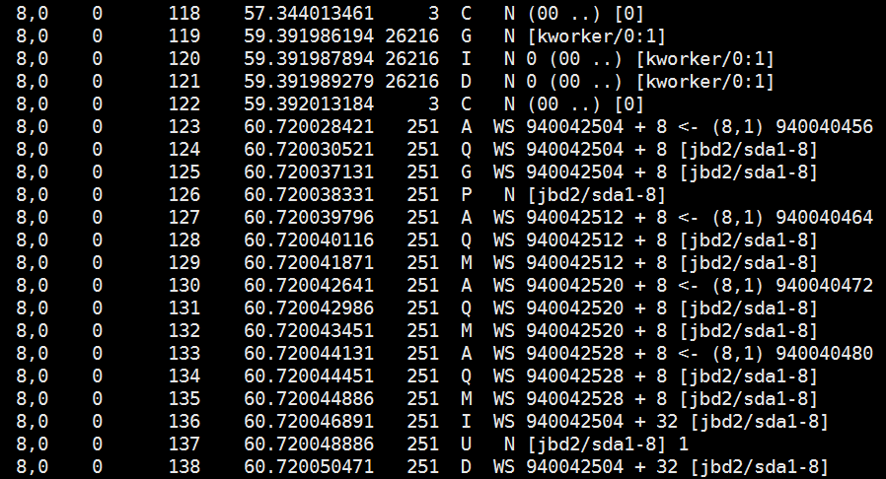
Usage
btrace shows block operations

Slide 10
Usage
Terminate btrace
Ctrl + C
‘sudo killall -15 btrace blktrace`

Slide 11
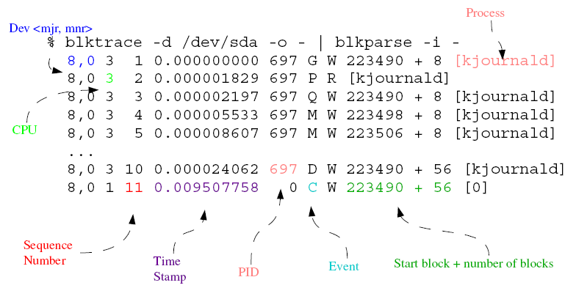
Analyze the result

Slide 12
Main events
D – IO is issued
M – IO is merged
C – IO is completed

Slide 13
Main IO
R, RS, RM – Read
W, WS, WM – Write
F, FW, FWF, FWFS – fsync or flush

Slide 14
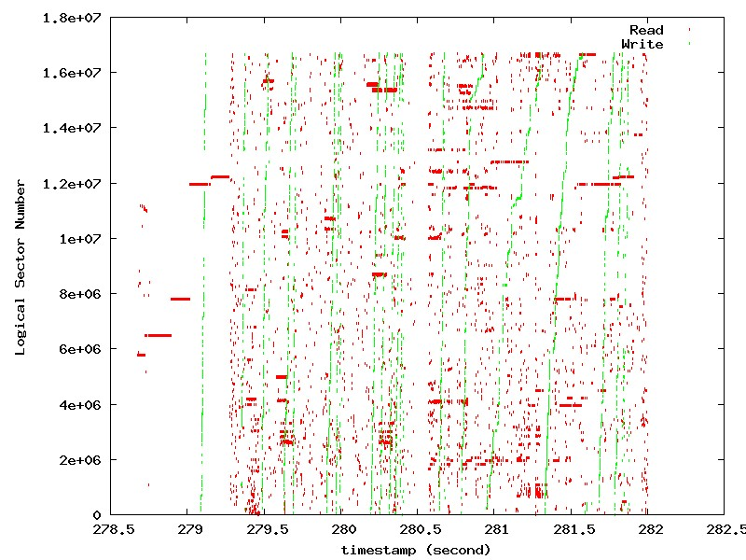
Draw a result

